Slide 1
Human Gender Identification Using Metabolomics Data
BIL 496
Preliminary Presentation
Zafer Altay
Project Mentor: Doç. Dr. Habil KALKAN
March 2022

Slide 2
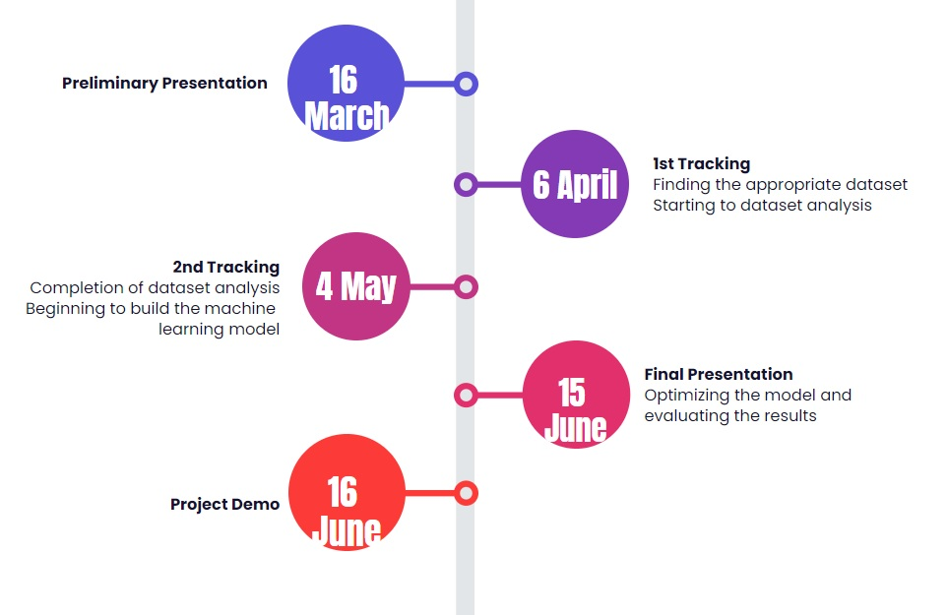
Timeline

Slide 3
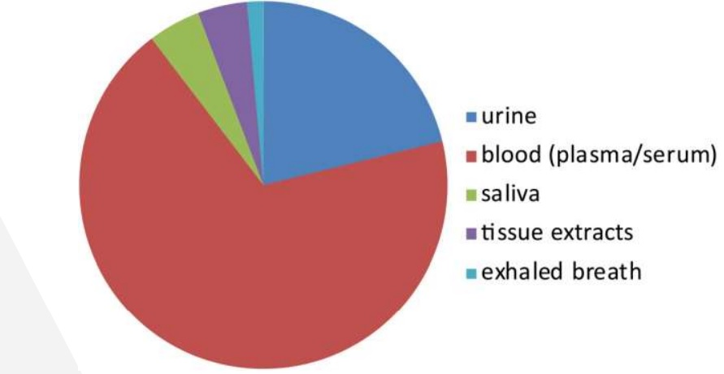
Sample Collection

Slide 4
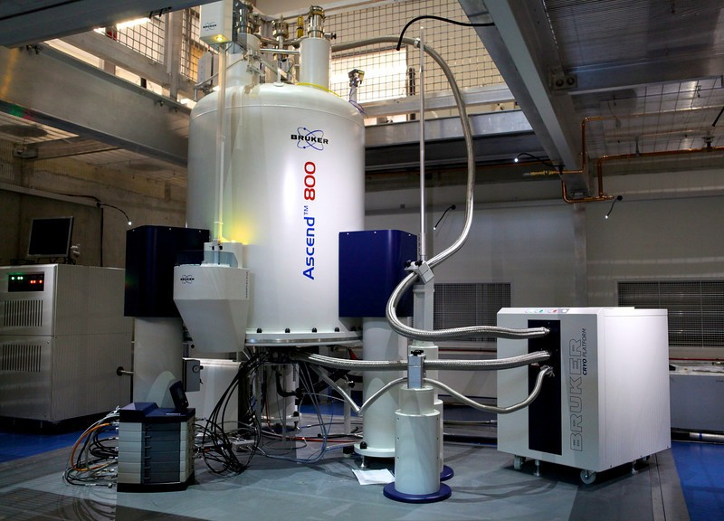
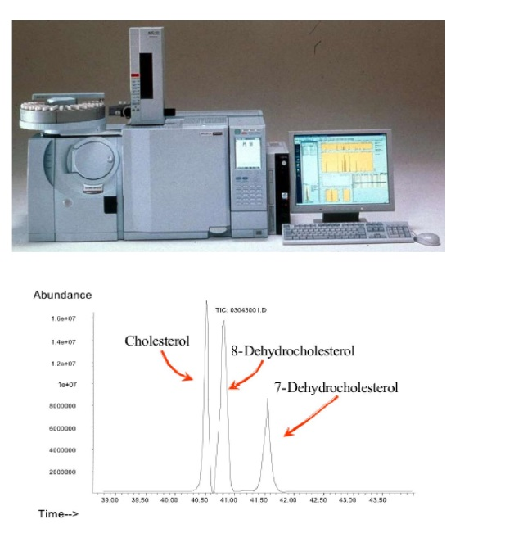
Analysis Techniques
NMR
GC*GC-MS
GC-MS
LC-MS

Slide 5
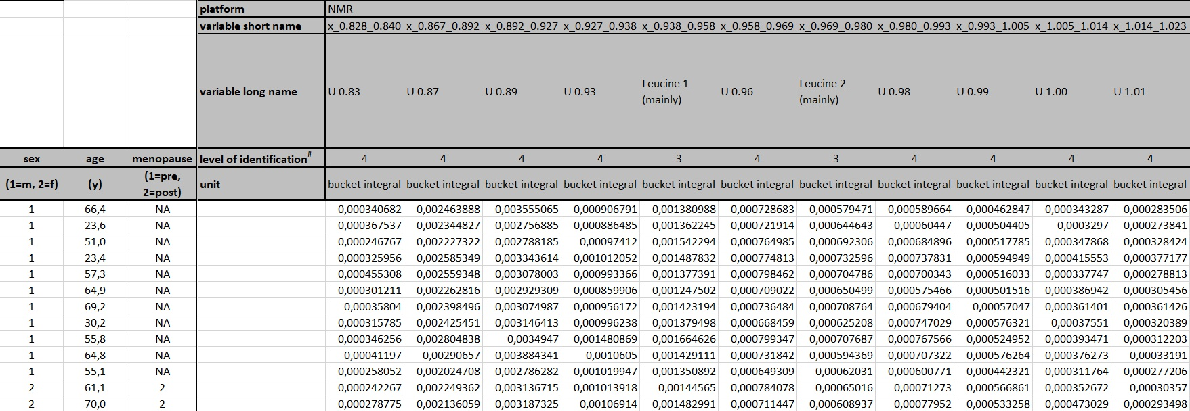
Dataset Details
172 Men
129 Women
18-80 Aged
400+ Plasma and 500+ Urine Metabolites

Slide 6
Resources
https://stringfixer.com/tr/Metabolomics
https://www.metaboanalyst.ca/docs/Format.xhtml
https://www.metabolomicsworkbench.org/
https://hmdb.ca/
https://pubmed.ncbi.nlm.nih.gov/?term=%22Metabolomics%2Fmethods%22%5BMAJR%5D&page=2

